Slide 1


HR Employee Attrition Analysis
RATAN ERABATHINI
VIVEK PATTEBAHADUR
YADNESH KOLHE
SWAPNEEL INGLE
Data Science Program-DSP WD2-Thane

Slide 2
Problem Definition
Understand the problem and objective:
Employee Attrition is a huge problem across industries and generally costs the company a lot for hiring, retraining, productivity and work loss for each employee who leaves.
To understand weather an employee quits at the earliest, we need to build model to predict whether an employee would quit in the near future.

Slide 3
OBJECTIVE
The objective of this project is to build a data model which will
Identify the factors influencing attrition
Predict possible attrition
Identify possible ways to retain high performers.

Slide 4
Data Information
1111 Observations and 13 Features

Slide 5
Exploratory Data Analysis

Slide 6
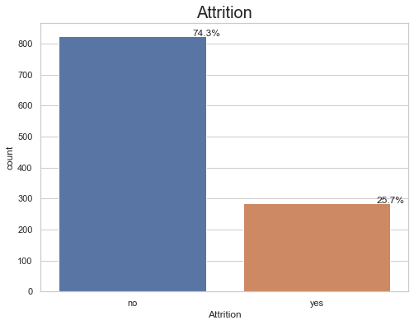
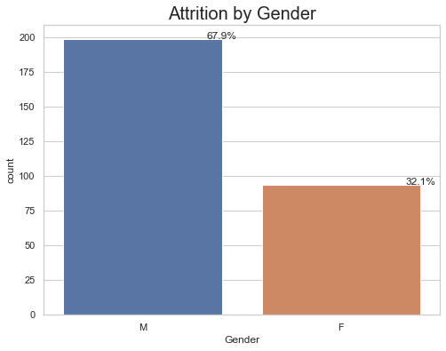
Attrition
Attrition of employee :-
As per above graph, the employee attrition is approximate 25 %

Slide 7
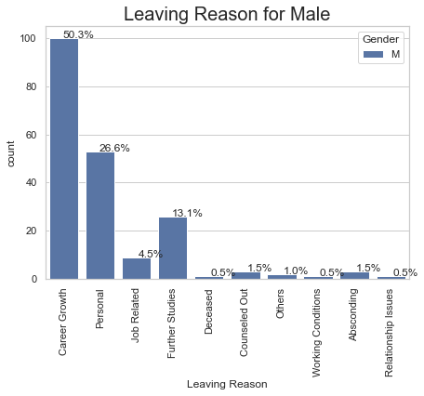
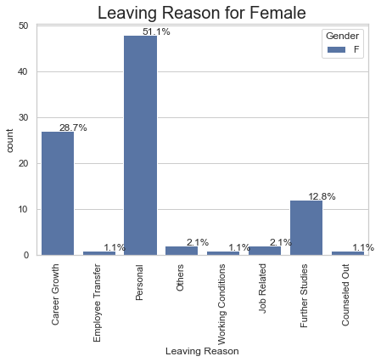
Attrition : Gender vs Leaving Reasons
50.3 % Men’s & 28.7% female’s lefts for the Career growth.
51.7 % Women’s & 26.6% male’s lefts for Personal reasons.

Slide 8
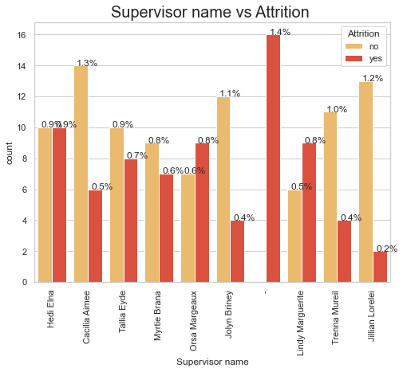
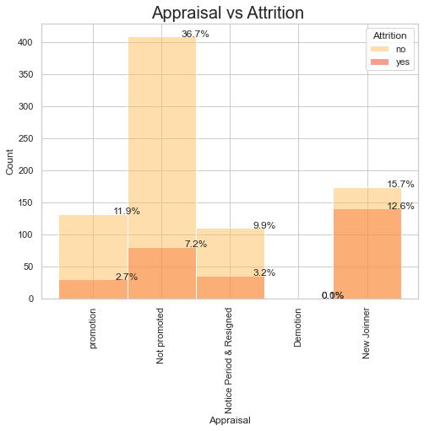
Supervisor name vs Attrition & Appraisal vs Attrition
As per below graph analysed the below pointers :
Most Employee are leaving under supervisor name Orasa Margeaux and lindy marguerite with highest rate of attrition compared to others.
If employee got Demotion , 40-45% chances he/she left the company.

Slide 9
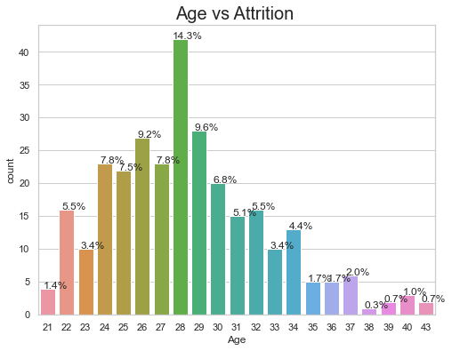
Age vs Attrition :
65 to 75 % employees lefts the company below age of 30 .
Max employee left the company at the age of 28 i.e 14.3%

Slide 10
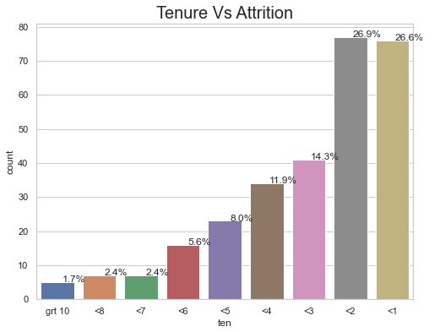
Tenure vs Attrition
Most of the Employee are leaving the company who worked less than 2 years.
26.6% of the Resigned Employee falls under less than 1 year of working in company.
26.9% of the Resigned Employee falls under less than 2 year of working in company.

Slide 11
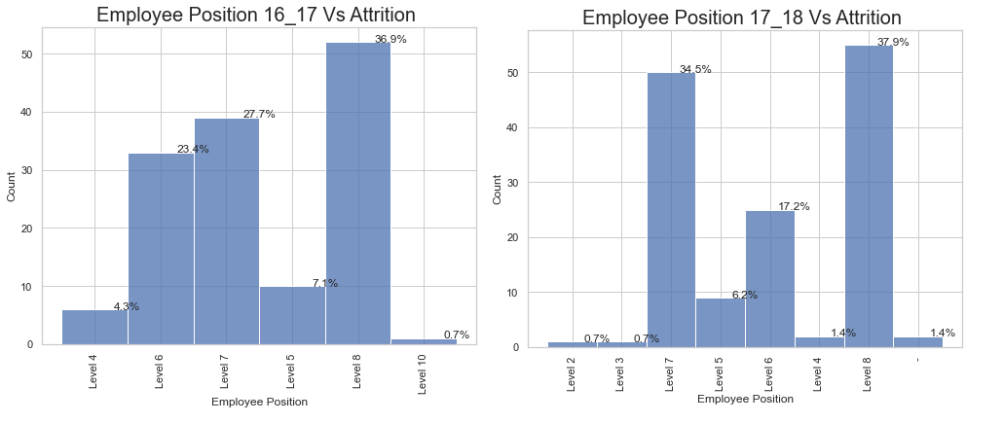
Employee Position 2016-17 & 2017-2018 vs Attrition

Slide 12
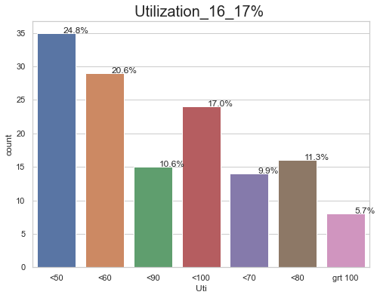
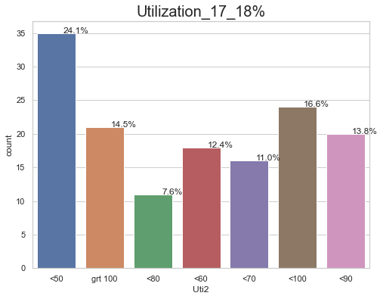
Utilization 2016-17 & 2017-2018 vs Attrition
As per below graph , analysed the below points for only Resigned data:
Most Employee are leaving below 50% & 60% of Utilization in year 2016-17.
Most Employee are leaving below 50% of utilization in year 2017-18.
Analysing the following graph, Employee having greater than 90% of utilization must be Retained

Slide 13
Data Cleaning and Preparation

Slide 14
Data cleaning and preparation
Create and Drop Columns
Feature Scaling
Model Building
Splitting the dataset into the Training set and Testing set

Slide 15
Machine Learning

Slide 16

Applying Machine Learning Algorithms
Logistic Regression
Decision Tree Classification
K-NN Classification
SVM Classification
Random Forest Classification

Slide 17
Model Comparison

Slide 18
Model Comparison
Algorithm | Precision | Recall | F1-score | Accuracy
Logistic Regression | 0.76 | 0.70 | 0.73 | 0.85
KNN | 0.90 | 0.86 | 0.88 | 0.93
Random Forest | 1 | 0.98 | 0.99 | 0.99
Decision Tree | 0.98 | 0.95 | 0.96 | 0.98
SVM(Classification) | 0.97 | 0.61 | 0.75 | 0.88

Slide 19
Testing the model

Slide 20
Conclusion

Slide 21
Recommendation

Slide 22
Thank You

